Slide 1

Mobile Car Fault Diagnosis Application
Requirement Gathering Phase
BY GROUP 8

Slide 2
Why is it Important?
What is it?
It is important due to the technical complexity of car diagnosis, safety concerns, and user trust issues.
It involves collecting user and expert needs before development
NOTE
The application is designed as a first -level diagnostic assistant, not a replacement fir professional mechanics

Slide 3

Problem Statement
1. MANY DRIVERS STRUGGLE TO UNDERSTAND CAR FAULTS
2. CAN’T IDENTIFY ENGINE SOUNDS
This leads to:
Ignoring serious issues and unsafe driving decision
Over pricing from mechanics on basic issues

Slide 4

Stake Holders
These are individuals, groups, or entities that are affected by the system, contribute to it’s design, or have an interest in it’s success.
We grouped our stake holders into to categories:
Primary Stake Holders
Secondary Stake Holders

Slide 5
Stake Holders Categories
Car Owners/Drivers(Primary)
Main users who need help understanding warning lights and engine sounds
Mechanics(Primary)
Provides expert knowledge and ensures the app gives safe and realistic advice
01
02
Auto Electricians(Primary)
Handle electrical and sensor-related faults such as battery and ABS issues
Car Providers(Secondary)
Supply tutorials and maintenance guidance to support users after diagnosis
03
04

Slide 6
Requirement Gathering Techniques
Main Techniques:
Questionnaire /Survey
The requirement gathering process was designed around the nature of the application. SO, the techniques selected had to collect information from both ordinary car owners and people with technical vehicle repair experience
Interviews
Brainstorming
4Main Techniques
Review of existing applications

Slide 7
Questionnaire/Survey
The Questionnaire covered:
Driving experience and vehicle use
Understanding of dashboard warning lights
Experience with abnormal engine sounds
Common actions taken when a vehicle fault occurs
Interest in using a mobile car fault diagnosis application
Preferred app features* Willingness to use camera and microphone-based diagnosis
Trust and reluctance toward app-based diagnosis.
A questionnaire was used to gather data from car owners about warning lights, engine sounds, and their interest in the application. It helped identify user challenges, preferences and trust concerns

Slide 8
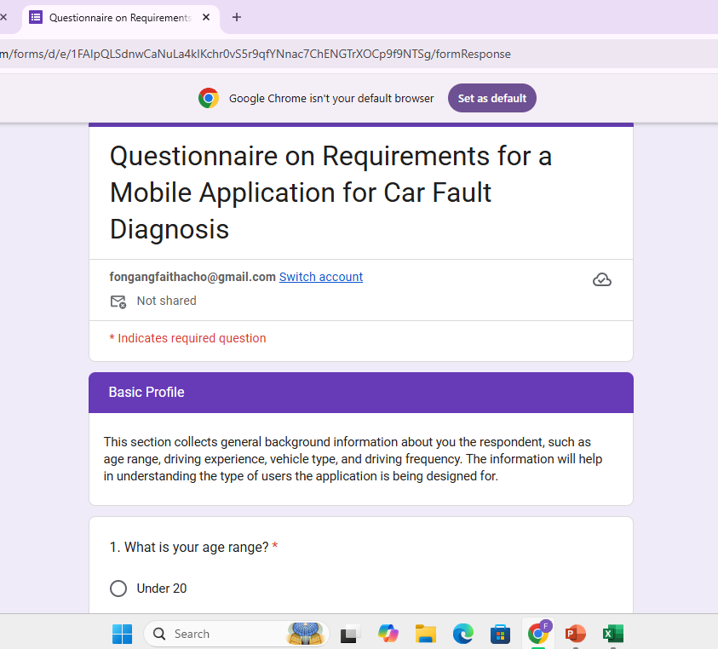
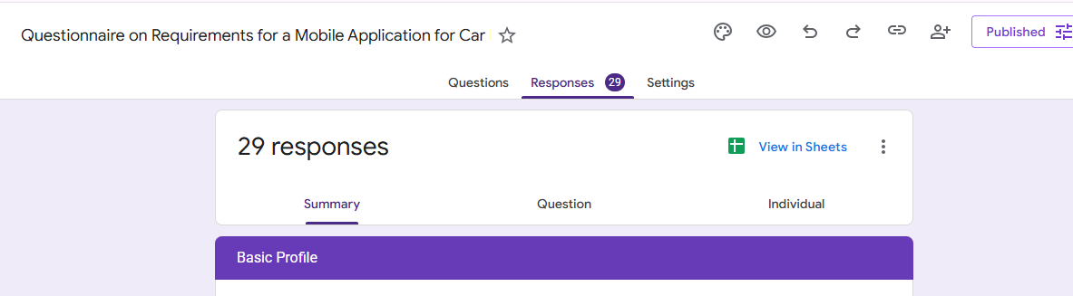
Questionnaire/Survey

Slide 9
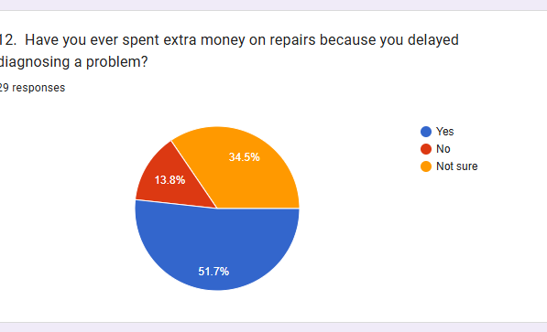
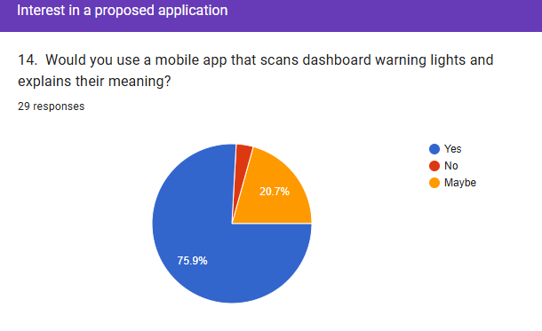
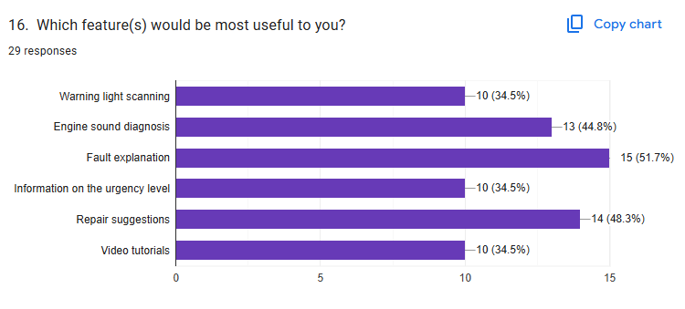
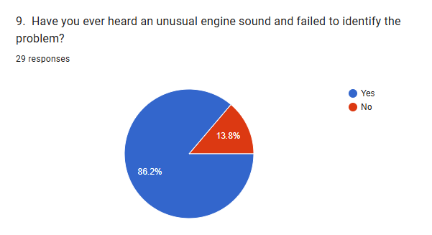

Slide 10
Interviews
The Interviews focused on:
Common dashboard warning lights misunderstood by drivers
Common mistakes drivers make when warning lights appear
Abnormal engine sounds frequently reported by car owners
Possible causes of sounds such as knocking, hissing, squealing, rattling, and grinding
Faults that are urgent and require immediate attention
Faults that can be monitored temporarily
Types of advice that are safe for an app to give
Types of advice that should only be handled by mechanics
Limitations of phone-based diagnosis
Concerns about users over trusting the app.
Interviews were conducted with technicians, auto electricians, and vehicle technicians tp gather expert knowledge on cars faults. This helped ensure the system provides safe,accurate, and realistic diagnostic suggestions

Slide 12
Reverse Engineering
We considered:
OBD (On Board Diagnostics) related applications2.
Dashboard warning light guide applications/resources.
Car maintenance tutorial applications/resources
Sound recognition/diagnostic tools
Reverse engineering was used to study existing applications and resources that are related to the proposed car fault diagnosis applications

Slide 13

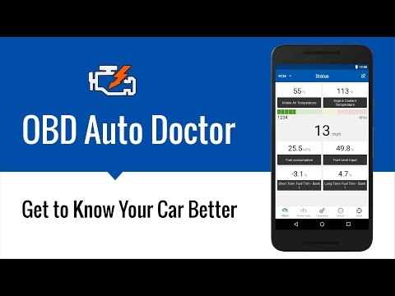
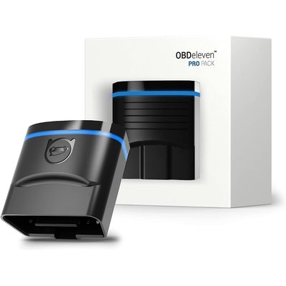
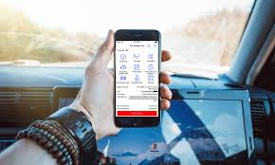
Existing Solutions
Car Scanner ELM OBD2
OBD auto doctor
OBDeleven
A snapshot of the current competitive landscap

Slide 14
Brainstorming
We considered:
What should happen when a user opens the app?
Should the app start with dashboard scanning, sound recording, or a home menu?
How should results be displayed to non-technical users?
What information should be shown after a warning light is detected?
How can the app show urgency clearly?
Should the app work offline?
How can mechanic confirmation be encouraged without making the app seem useless?
What features should be included in the first version?
What features should be postponed to future versions?
Brainstorming was used to generate ideas based on user feedback and expert input. It helped transform collected data into practical features and system design decisions for the application.

Slide 15
Summary of Key Findings
86.2%
86.2%
62.1%
75.9%
Of respondents had seen a dashboard warning light they did not understand
Had heard an unusual engine sound they could not identify
Had ignore warning lights because they did not understand them
Indicated willingness to use a warning-light scanning application
72.4%
89.7%
86.2%
79.3%
Indicated willingness to use an engine sound diagnostic feature
Preferred basic offline diagnosis
Wanted expert video links
Would till confirm the diagnosis with a mechanic

Slide 16
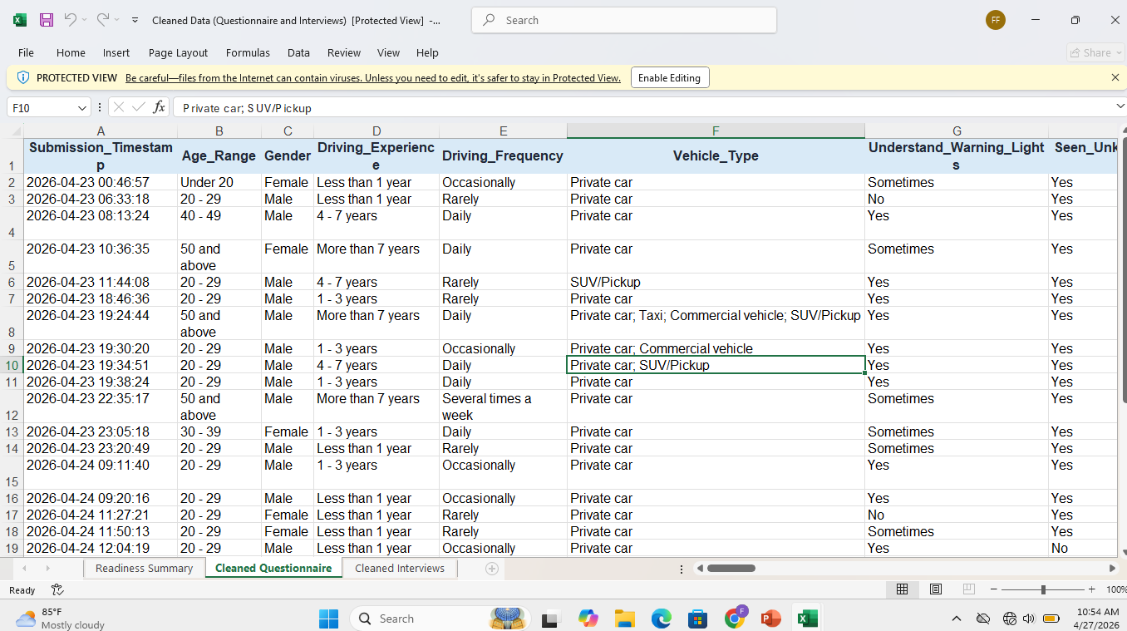
Data Cleaning

Slide 17


THYNK UNLIMITED
REALLYGREATSITE.COM
Challenges
Limited participation
Low response Motivation
Expert Reluctance
Trust Issues
Many potential participants ignored or postponed completing the form, possibly due to lack of interest, time constraints, or unclear study purpose.
Some mechanics were unwilling to participate, mainly due to suspicion and concerns about the app affecting their profession
Some users hesitated to share information because they did not fully trust or understand the purpose of the system being developed
Only a small number of users responded to the questionnaire, indicating moderate engagement during the data collection process

Slide 18

Conclusion
The requirement gathering phase provides a good foundation for the proposed Mobile Application for Car Fault Diagnosis by identifying the main stakeholders, collecting data from car owners/drivers and technical experts reviewing related applications and organizing the findings for requirement analysis

